Slide 1
When Time Clauses
10

Slide 2
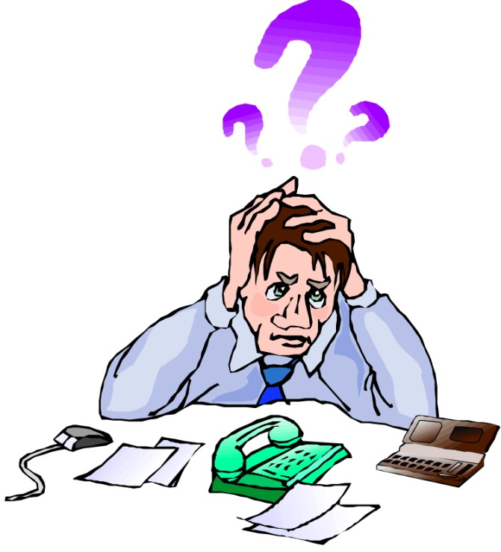
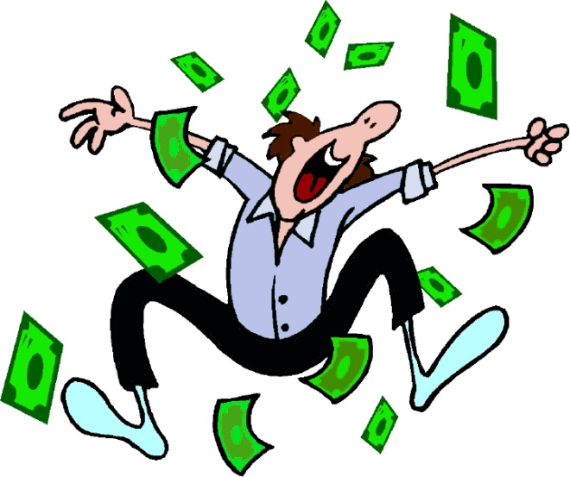
When I am stressed, I think happy thoughts.

Slide 3
When- Clauses
I’m an astronaut when I play with my friends.

Slide 4
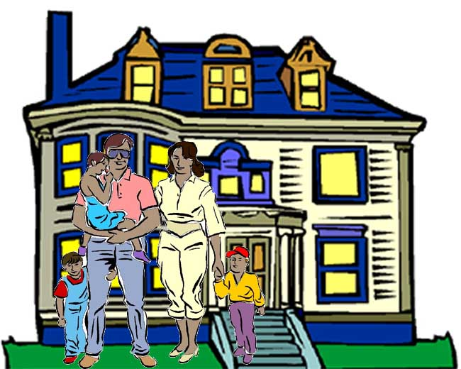
When- Clauses
When we go to a party, we lock the doors and windows.

Slide 5
When- Clauses
When I am stressed, I think happy thoughts.

Slide 6
Form
I go to the skateboard park
when I am bored.
Result Clause
When Clause

Slide 7
What do you do when…
you feel stressed?
you have an important exam at school?
you don´t understand a new word in English?
you are angry?
you are happy?

Slide 8
How do you feel when…
Your parents tell you «no»?
you have an important exam at school and you didn´t study?
A person ignores you?
You don´t eat breakfast?

